Slide 1
Just Another Movie:
Update 2
Kaitlyn Hardin, Robert Jones, Hayden Richard, Emmett Storey

Slide 2
Outline
Frontend
Backend
AI
Database
System Design
Conclusion

Slide 3
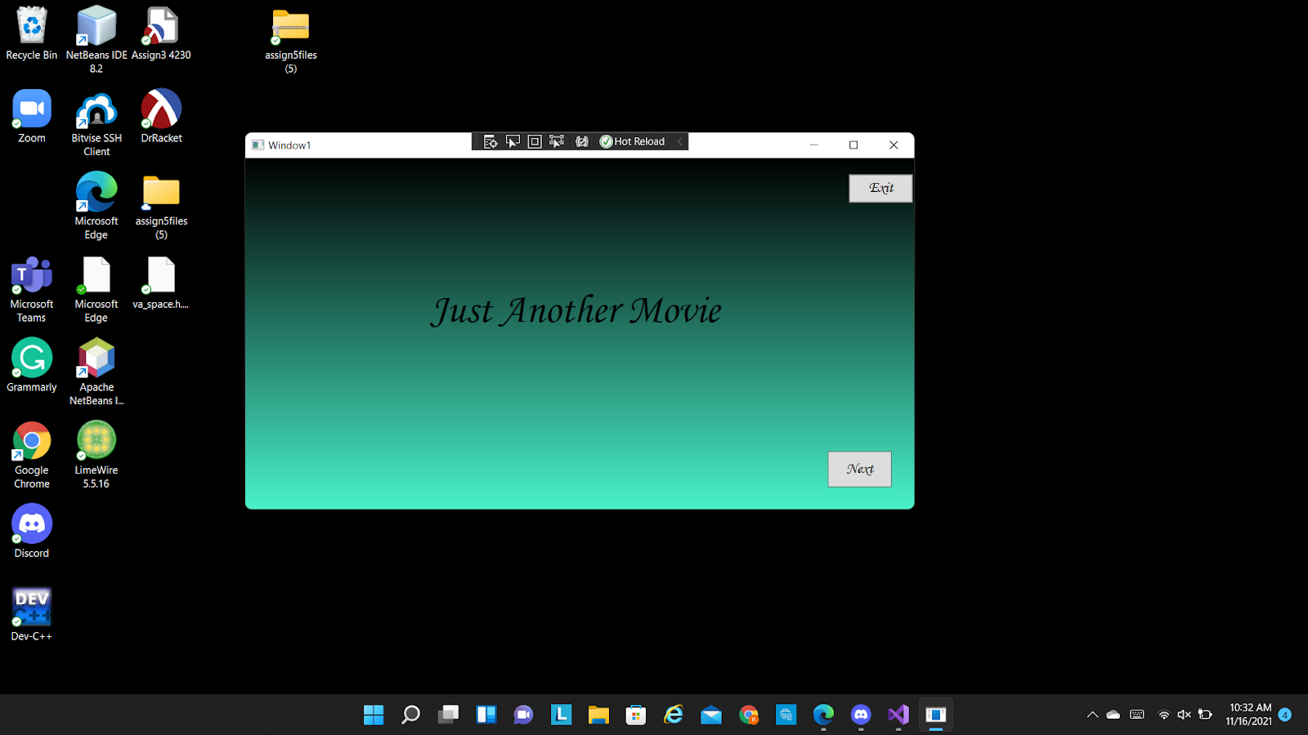
Frontend Development

Slide 4
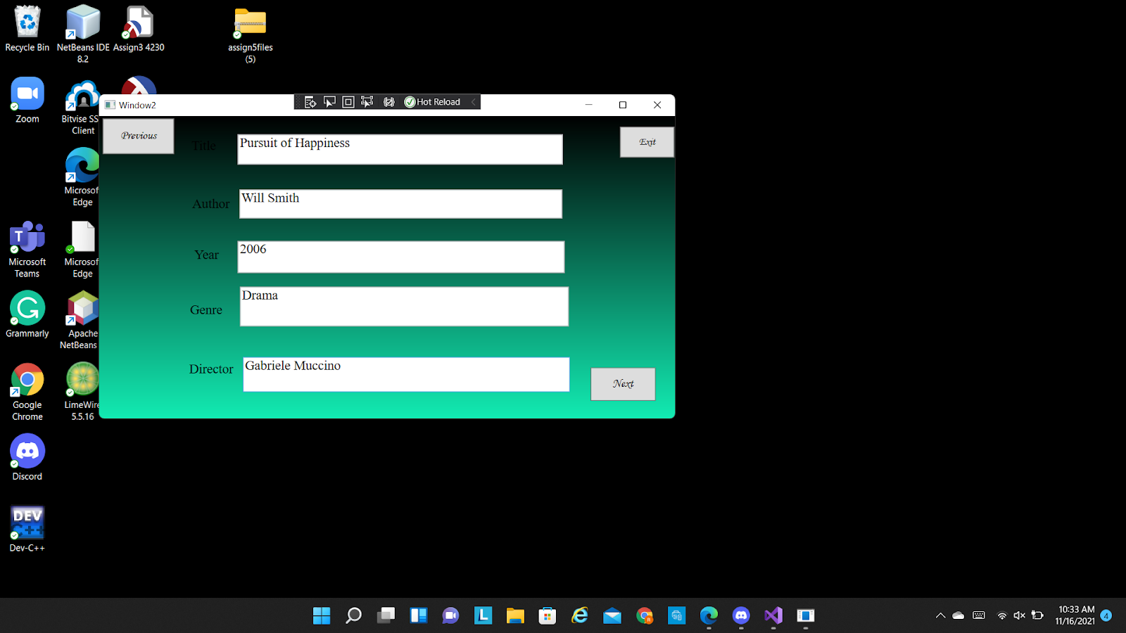
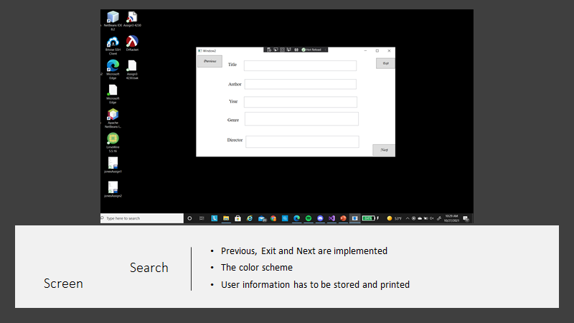
Search Screen

Slide 5
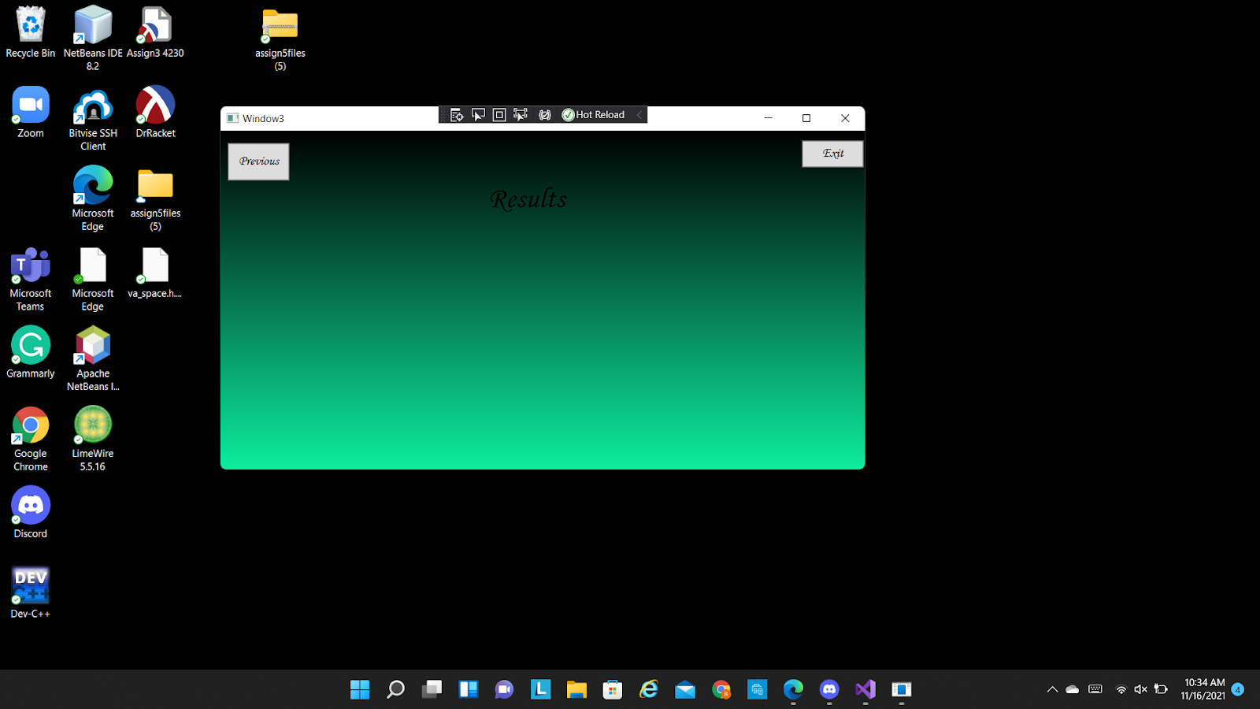
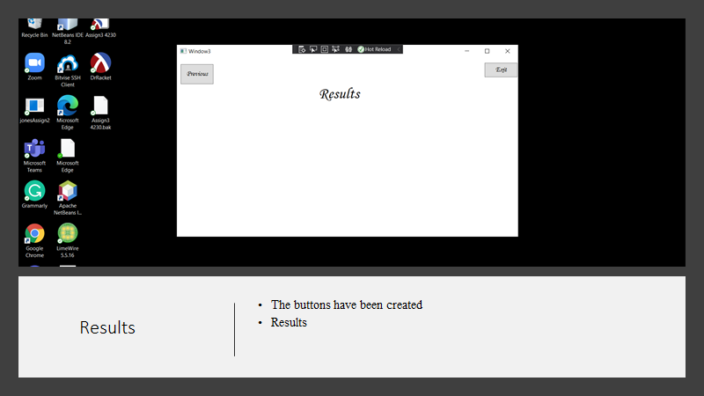
Results Page

Slide 6
Unfinished Business
Color Scheme of the application
1
Create a function to link backend
2
Implement drop down box if time permits
3

Slide 7
Backend Development
The test are still being made and adjustments are being made in the code to handle multiple genre inputs. Testing is mostly being postponed until the data is remodeled.
I need to change the List<int> variables in the Query methods to the QueryResults class used to hold the recommendations level and movie id of the results. The back end that interacts with the front end still needs to be implemented.

Slide 8
Backend Development Changes
Query class has been created to handle query search and mostly replaces the AI class.
allInputEmpty() has been removed from the ErrorHandling class.
An addMovie() method has been added to the MovieList class.
DirectorQuery(), ActorQuery(), TitleQuery(), YearQuery(), GenreQuery(), GetGenreIds(), FormMovieIdQuery() have been

Slide 9
Backend Development
Problem:
Due to the data needing to be remodeled this has pushed back my ability to run some of the tests. I have also ran into several problems when running what test I can. The main problem seems to be a read-write access error.

Slide 10
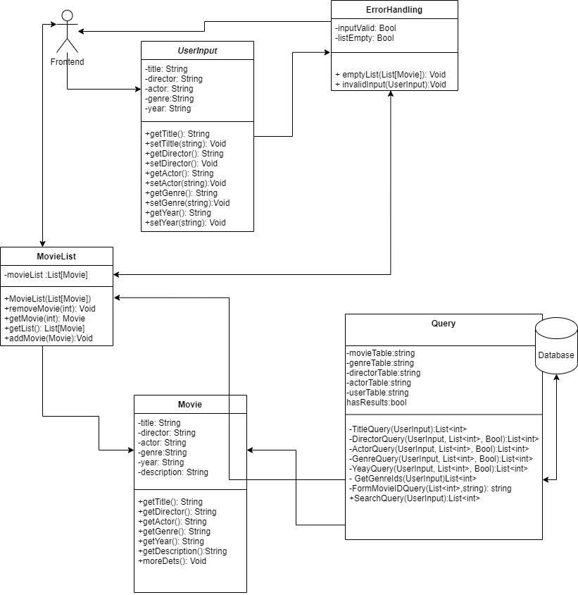
New backend Diagram

Slide 11
AI Development
What has been completed?
Have successfully built the AI and generated recommendations but with lower results than we want.
What still needs to be implemented?
Optimize the matrix factorization algorithm for better results.
Split the data into testing and training data sets.
Created a function to return the list of movies with recommendation score.
Getting the AI to work with the backend.
Short survey for the user to answer when they run the program.
Adding the new user reviews on the end of the csv file.

Slide 12
Problems Encountered with the AI
The model I chose to use won’t create recommendations unless the user is already in the testing data. So, we have to retrain the model for each recommendation.

Slide 13
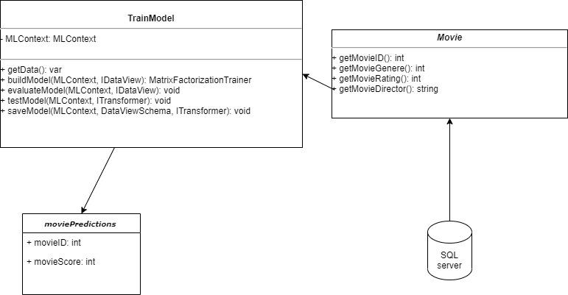
Old AI Design

Slide 14
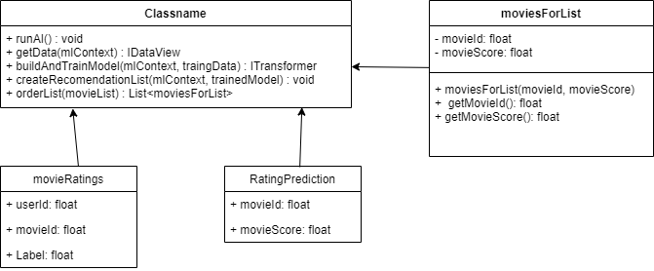
New AI Design

Slide 15
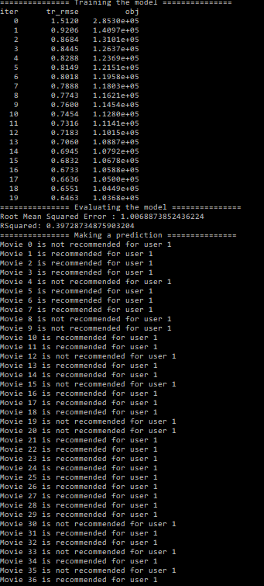
Example Output

Slide 16
Database Development
What’s fully implemented?
Database tables created
Database connection created
1
What’s started but not completed?
Inserting data in tables
2
What needs to be implemented?
Nothing
3

Slide 17
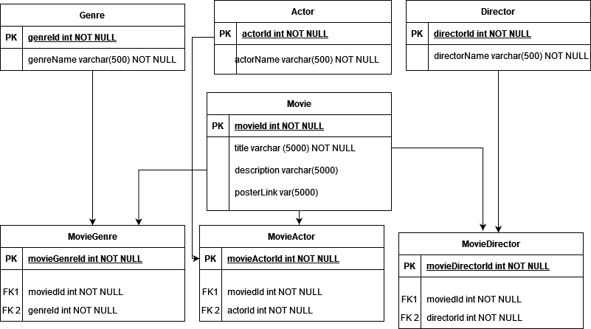

Slide 18
Database Development
Problem:
Extracting data

Slide 19
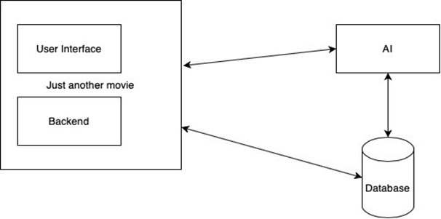
New System Design

Slide 20

Thank You For Listening!

